Slide 1

Big Data Infrastructure
CS 489/698 Big Data Infrastructure (Winter 2016)
Week 1: Introduction (2/2)
January 7, 2016
Jimmy Lin
David R. Cheriton School of Computer Science
University of Waterloo
These slides are available at http://lintool.github.io/bigdata-2016w/
This work is licensed under a Creative Commons Attribution-Noncommercial-Share Alike 3.0 United States See http://creativecommons.org/licenses/by-nc-sa/3.0/us/ for details

Slide 2
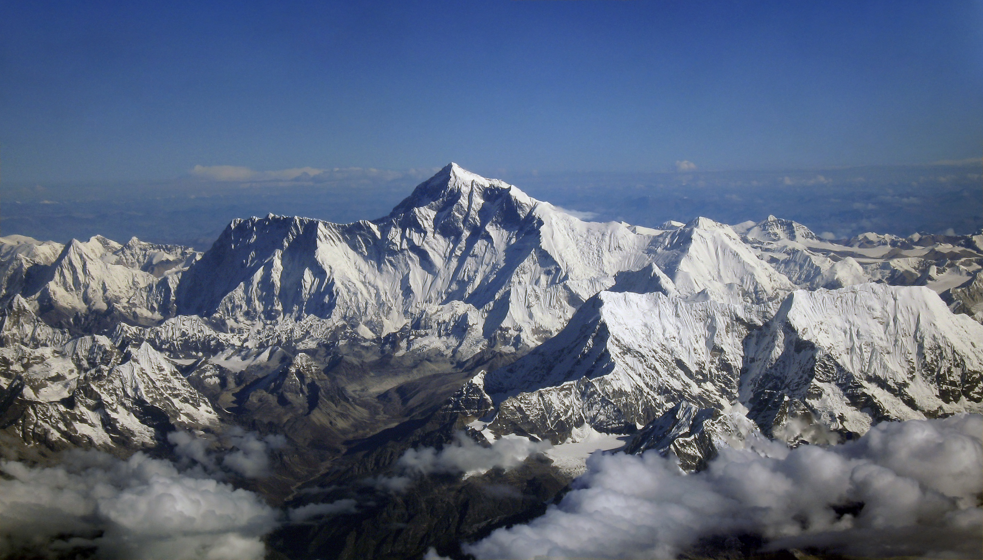
Why big data?
Science
Engineering
Commerce
Society
Source: Wikipedia (Everest)

Slide 3
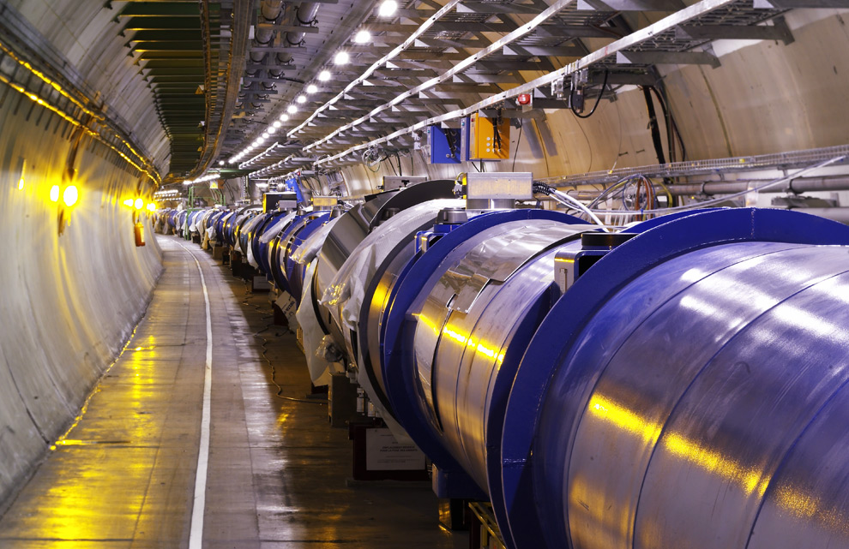
Science
Emergence of the 4th Paradigm
Data-intensive e-Science
Maximilien Brice, © CERN
Notes:
By the time it shuts down in 2011, the CERN collider should have amassed about 20 times as much data as it now has. (NYTimes article, “Trillions of Reasons to Be Excited”, 11/1/2010)

Slide 4
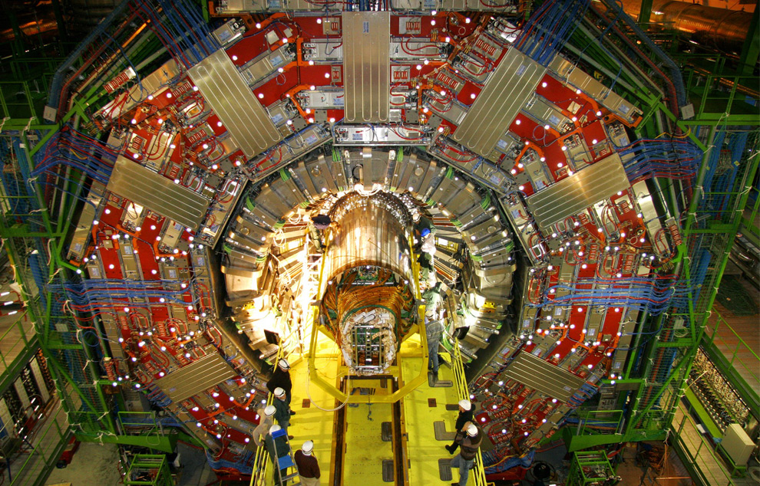
Maximilien Brice, © CERN

Slide 5
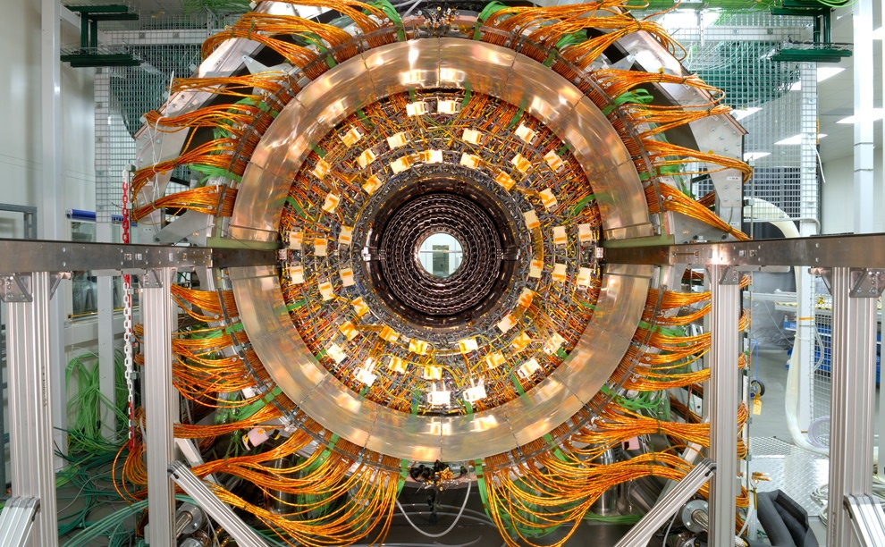
Maximilien Brice, © CERN

Slide 6

Source: Wikipedia (Galaxy)

Slide 7
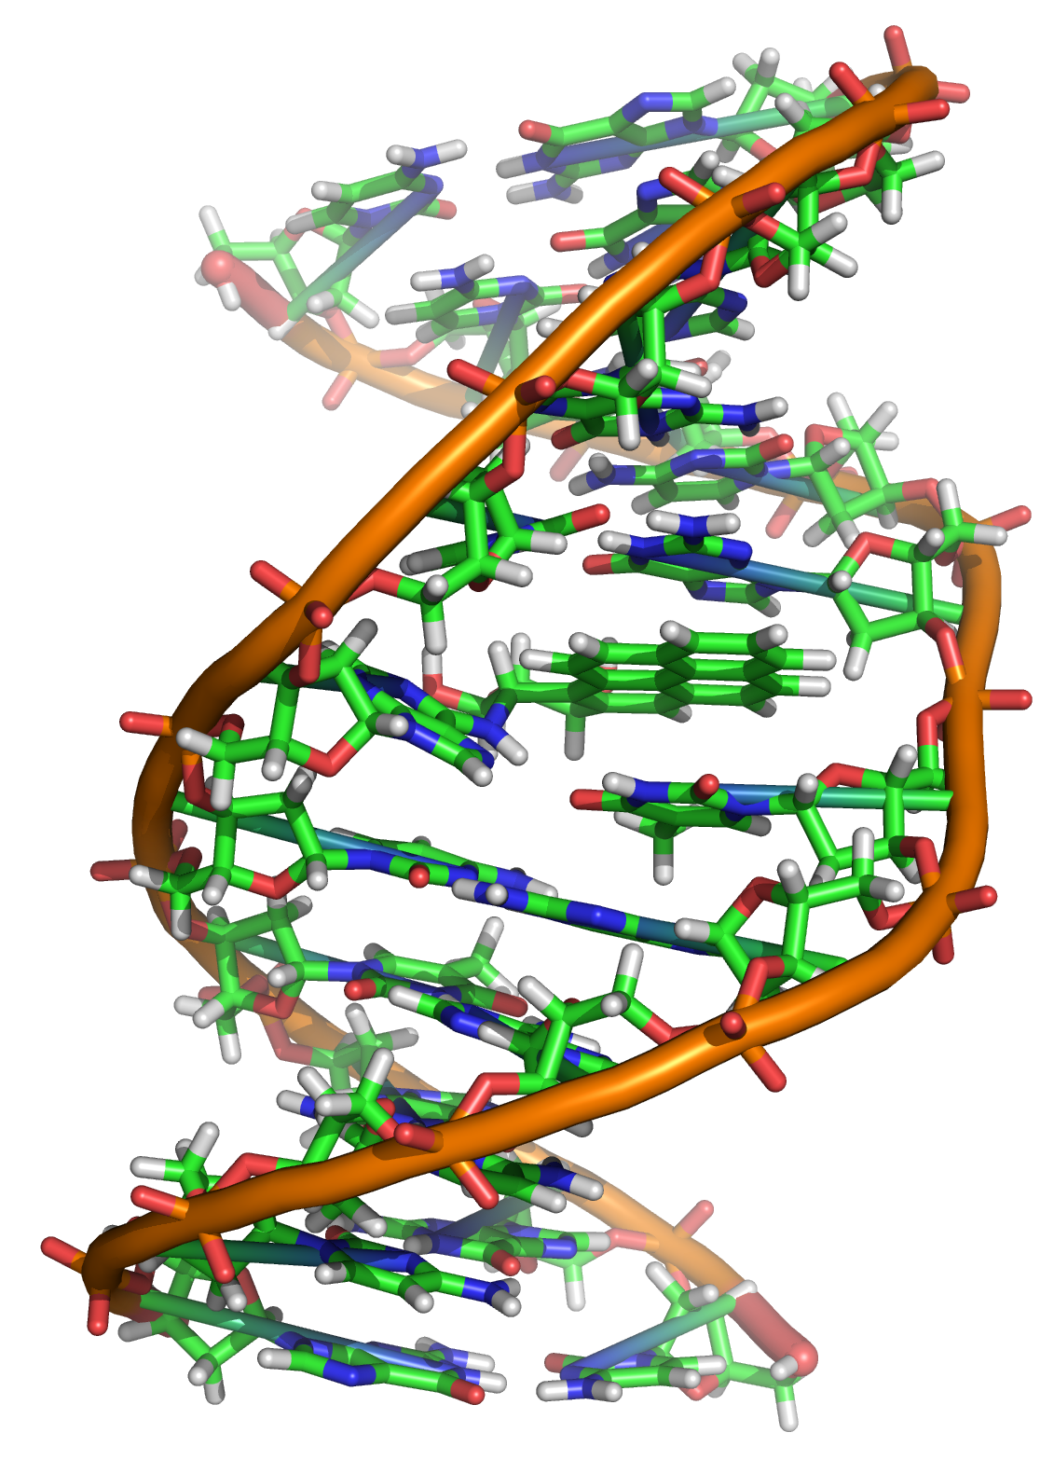
Source: Wikipedia (DNA)

Slide 8
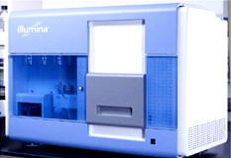
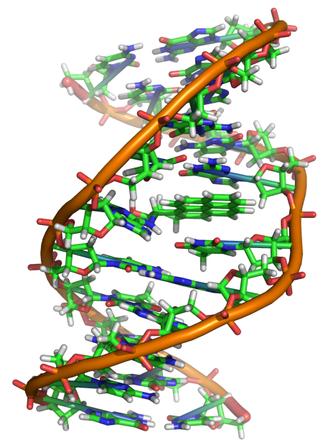
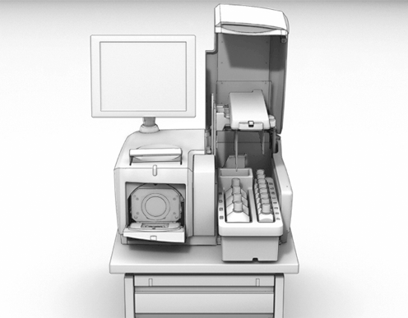
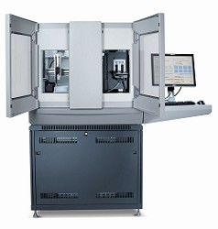
GATGCTTACTATGCGGGCCCC
CGGTCTAATGCTTACTATGC
GCTTACTATGCGGGCCCCTT
?
AATGCTTACTATGCGGGCCCCTT
TAATGCTTACTATGC
AATGCTTAGCTATGCGGGC
AATGCTTACTATGCGGGCCCCTT
AATGCTTACTATGCGGGCCCCTT
CGGTCTAGATGCTTACTATGC
AATGCTTACTATGCGGGCCCCTT
CGGTCTAATGCTTAGCTATGC
ATGCTTACTATGCGGGCCCCTT
Reads
Subject genome
Human genome: 3 gbp
A few billion short reads (~100 GB compressed data)
Sequencer

Slide 9
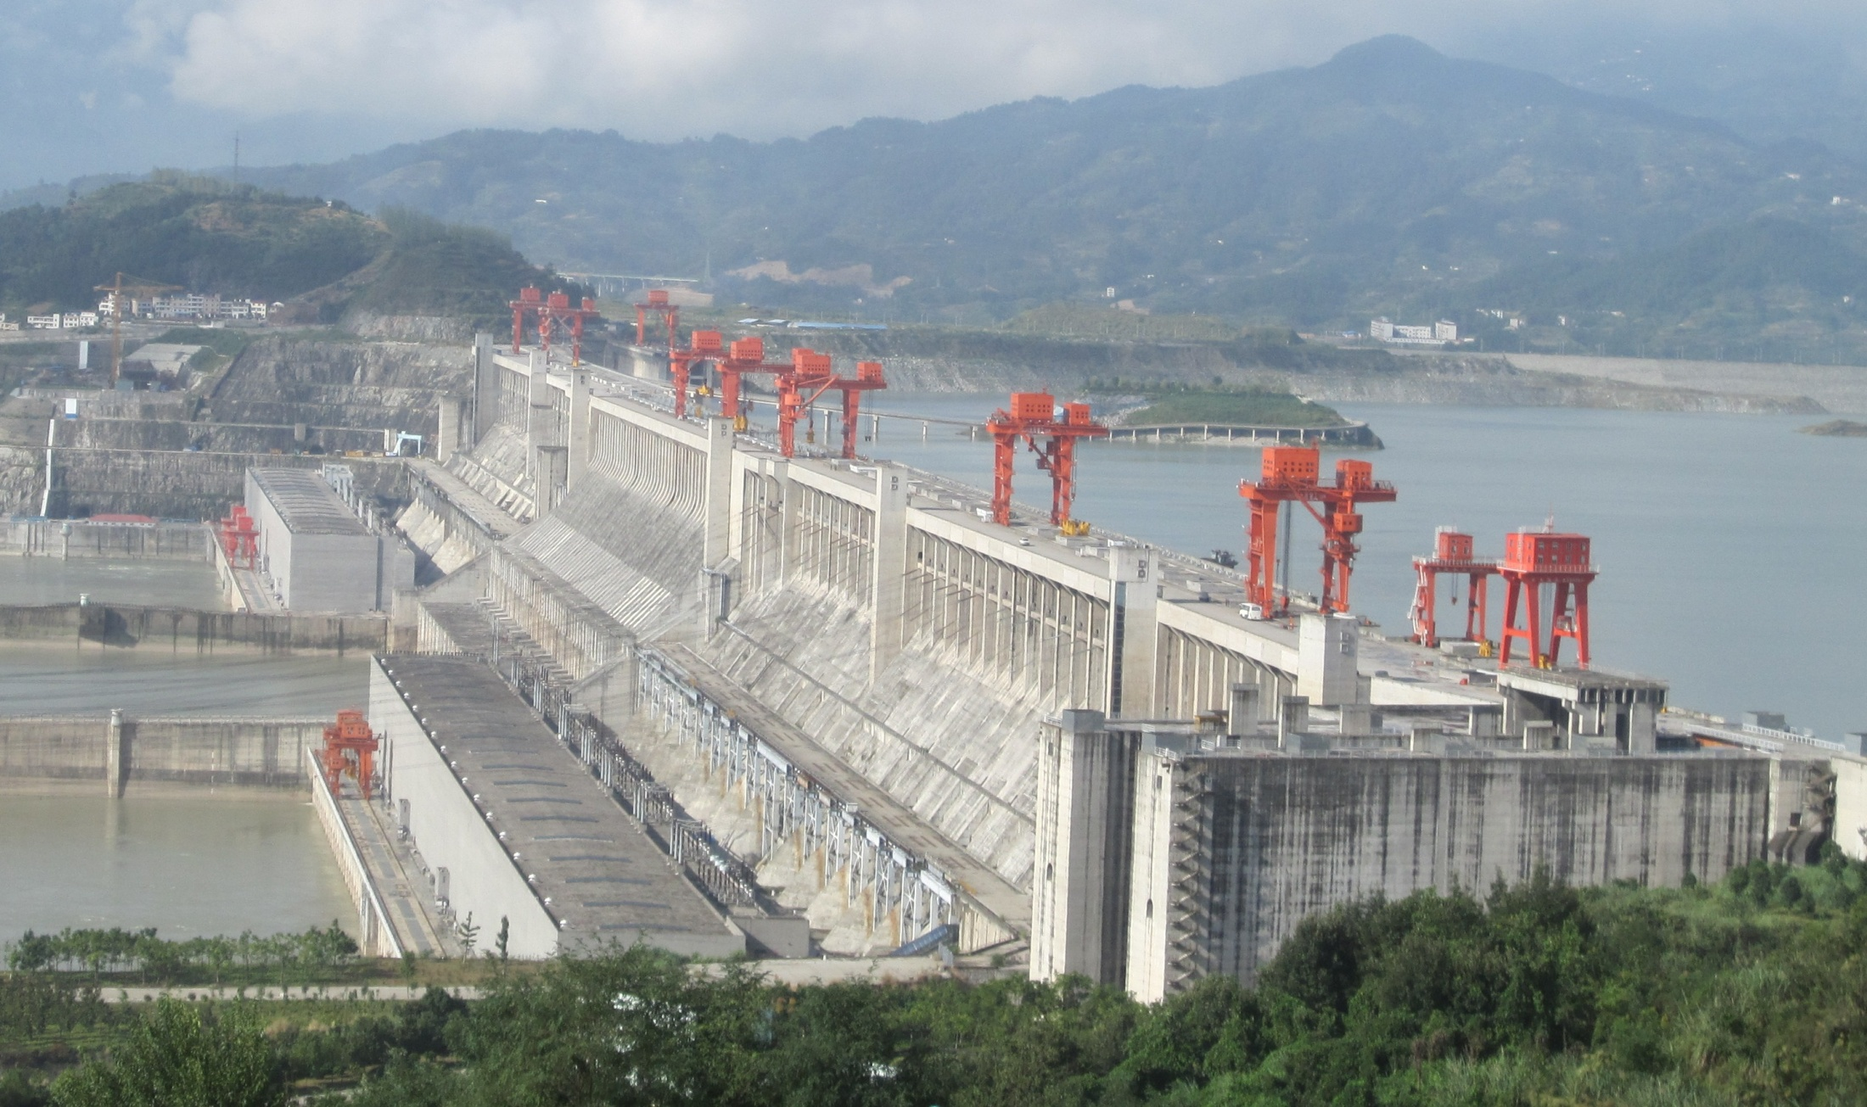
Engineering
The unreasonable effectiveness of data
Search, recommendation, prediction, …
Source: Wikipedia (Three Gorges Dam)

Slide 10
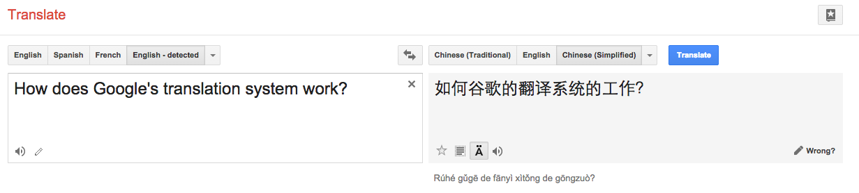

Slide 11

Source: Wikipedia (Rosetta Stone)

Slide 12
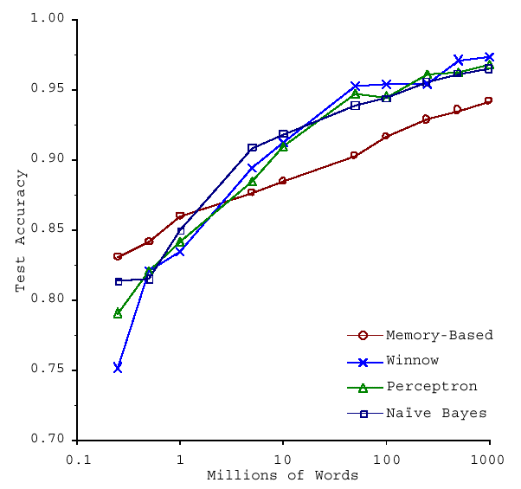
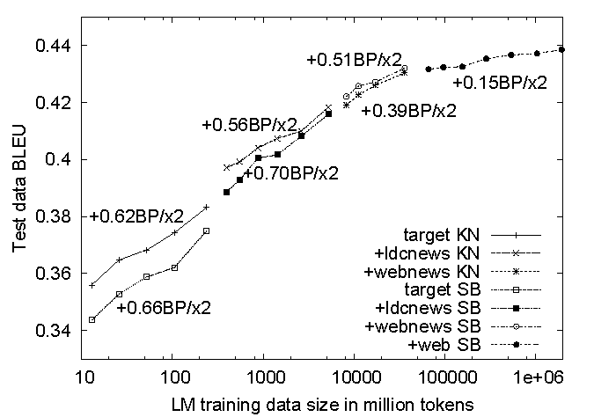
No data like more data!
s/knowledge/data/g;
(Banko and Brill, ACL 2001)
(Brants et al., EMNLP 2007)

Slide 13
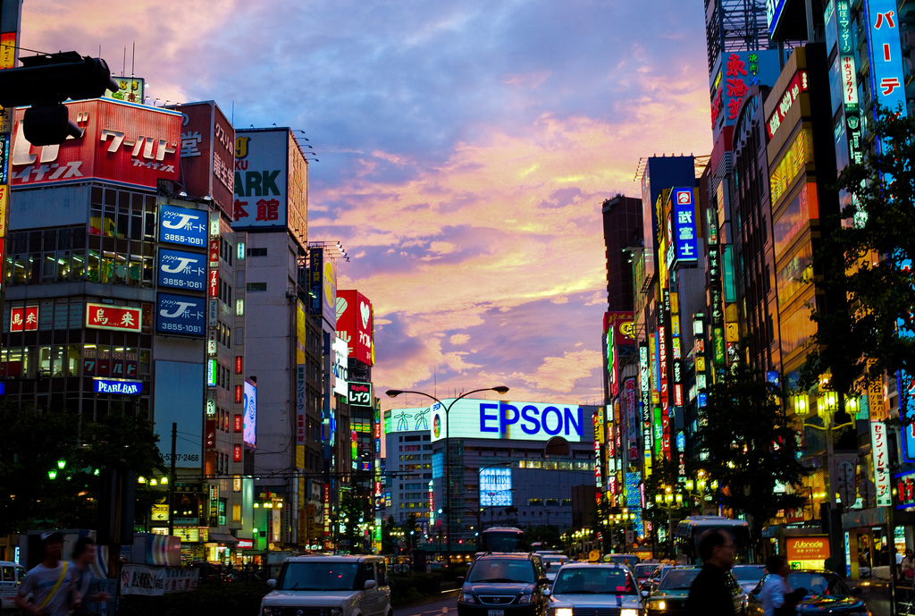
Know thy customers
Data → Insights → Competitive advantages
Commerce
Source: Wikiedia (Shinjuku, Tokyo)

Slide 14
Business Intelligence
An organization should retain data that result from carrying out its mission and exploit those data to generate insights that benefit the organization, for example, market analysis, strategic planning, decision making, etc.
Duh!?

Slide 15
Virtuous Product Cycle
a useful service
$ (hopefully)
transform insights into action
analyze user behavior to extract insights
Google.
Facebook.
Twitter.
Amazon.
Uber.
data products
data science

Slide 16
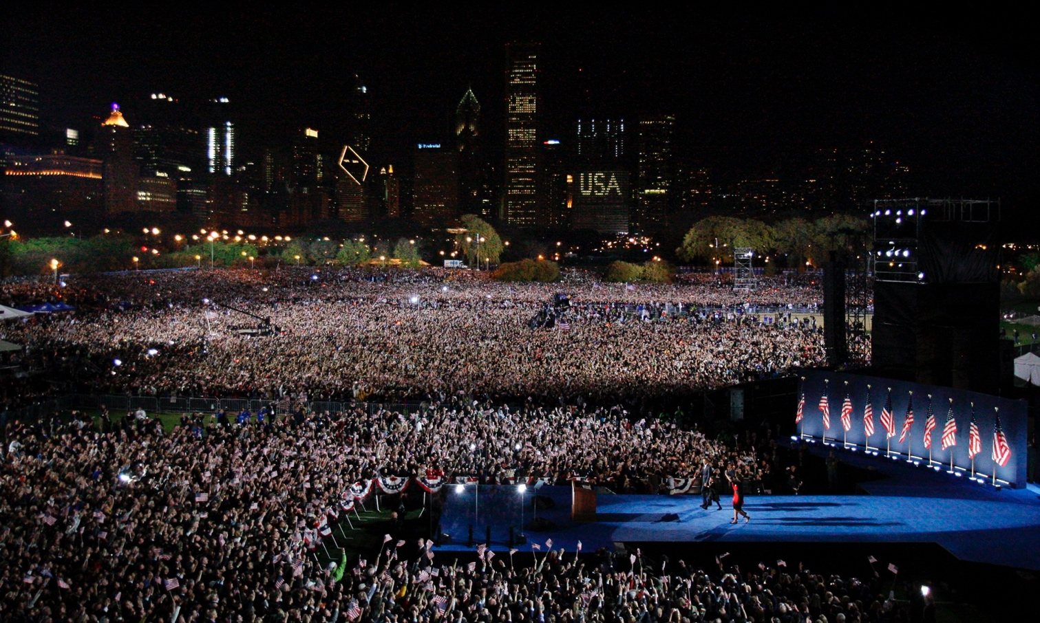
Society
Humans as social sensors
Computational social science
Source: Wikiedia (Guardian)

Slide 17
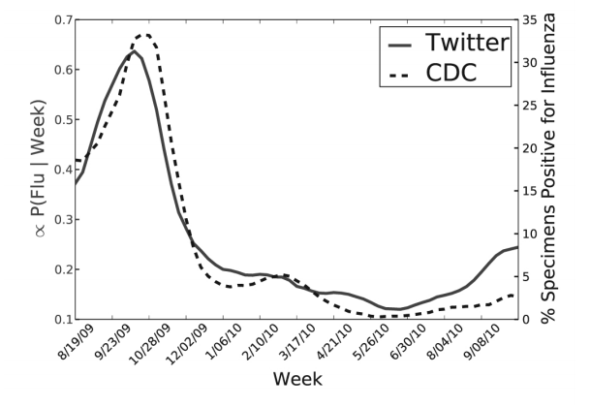
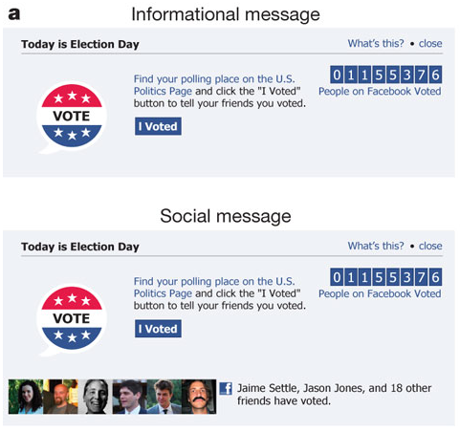
Predicting X with Twitter
2010 US Midterm Elections: 60m users shown “I Voted” Messages
Summary: increased turnout by 60k directly and 280k indirectly
Political Mobilization on Facebook
(Paul and Dredze, ICWSM 2011; Bond et al., Nature 2011)

Slide 18
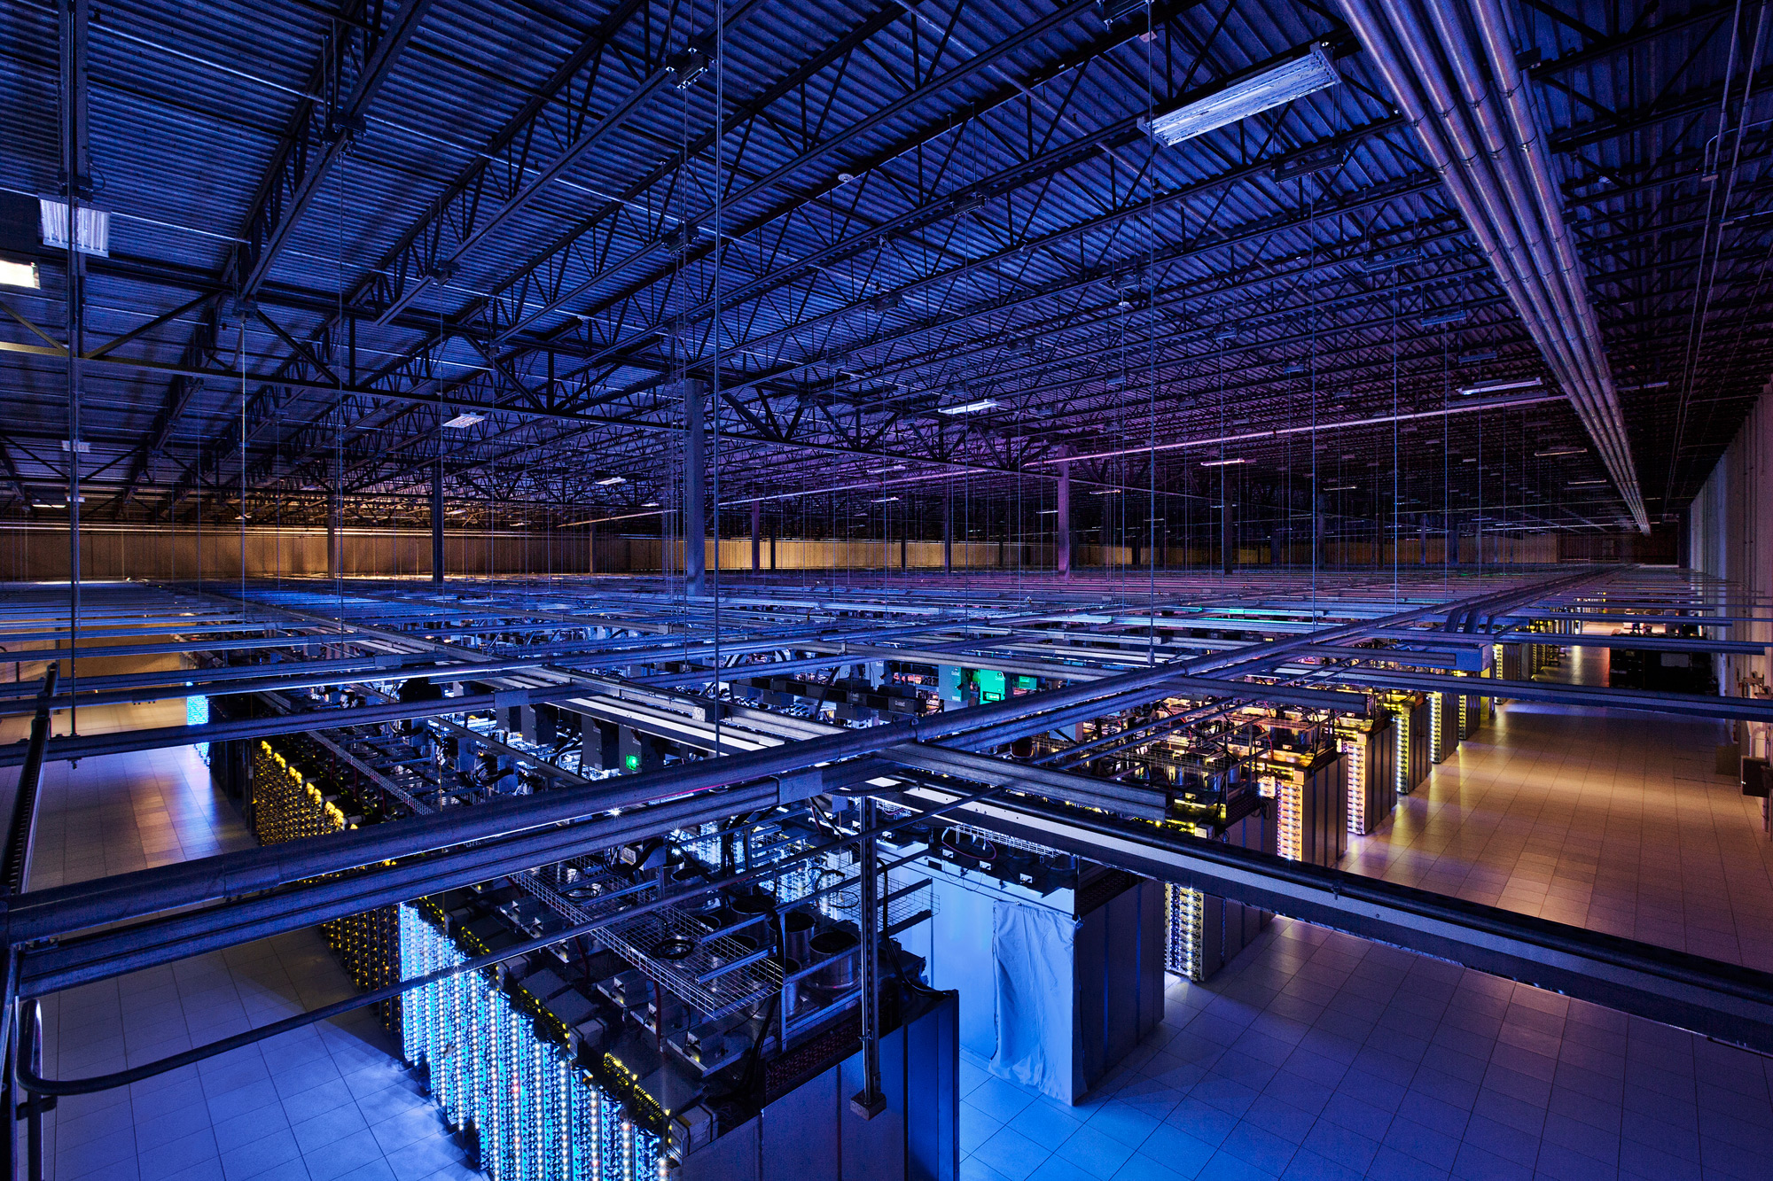
Tackling Big Data
Source: Google

Slide 19
k₁
v₁
k₂
v₂
k₃
v₃
k₄
v₄
k₅
v₅
k₆
v₆
map
map
map
map
a
1
b
2
c
3
c
6
a
5
c
2
b
7
c
8
combine
combine
combine
combine
a
1
b
2
c
9
a
5
c
2
b
7
c
8
partition
partition
partition
partition
Shuffle and Sort: aggregate values by keys
a
1
5
b
2
7
c
c
2
2
9
3
8
6
8
reduce
reduce
reduce
r₁
s₁
r₂
s₂
r₃
s₃

Slide 20
User Program
(1) submit
Master
(2) schedule map
(2) schedule reduce
worker
split 0
(6) write
output
file 0
split 1
(5) remote read
worker
split 2
(3) read
(4) local write
split 3
worker
split 4
worker
output
file 1
worker
Input
files
Map
phase
Intermediate files
(on local disk)
Reduce
phase
Output
files
Adapted from (Dean and Ghemawat, OSDI 2004)

Slide 21
The datacenter is the computer
It’s all about the right level of abstraction
Moving beyond the von Neumann architecture
What’s the “instruction set” of the datacenter computer?
Hide system-level details from the developers
No more race conditions, lock contention, etc.
No need to explicitly worry about reliability, fault tolerance, etc.
Separating the what from the how
Developer specifies the computation that needs to be performed
Execution framework (“runtime”) handles actual execution

Slide 22
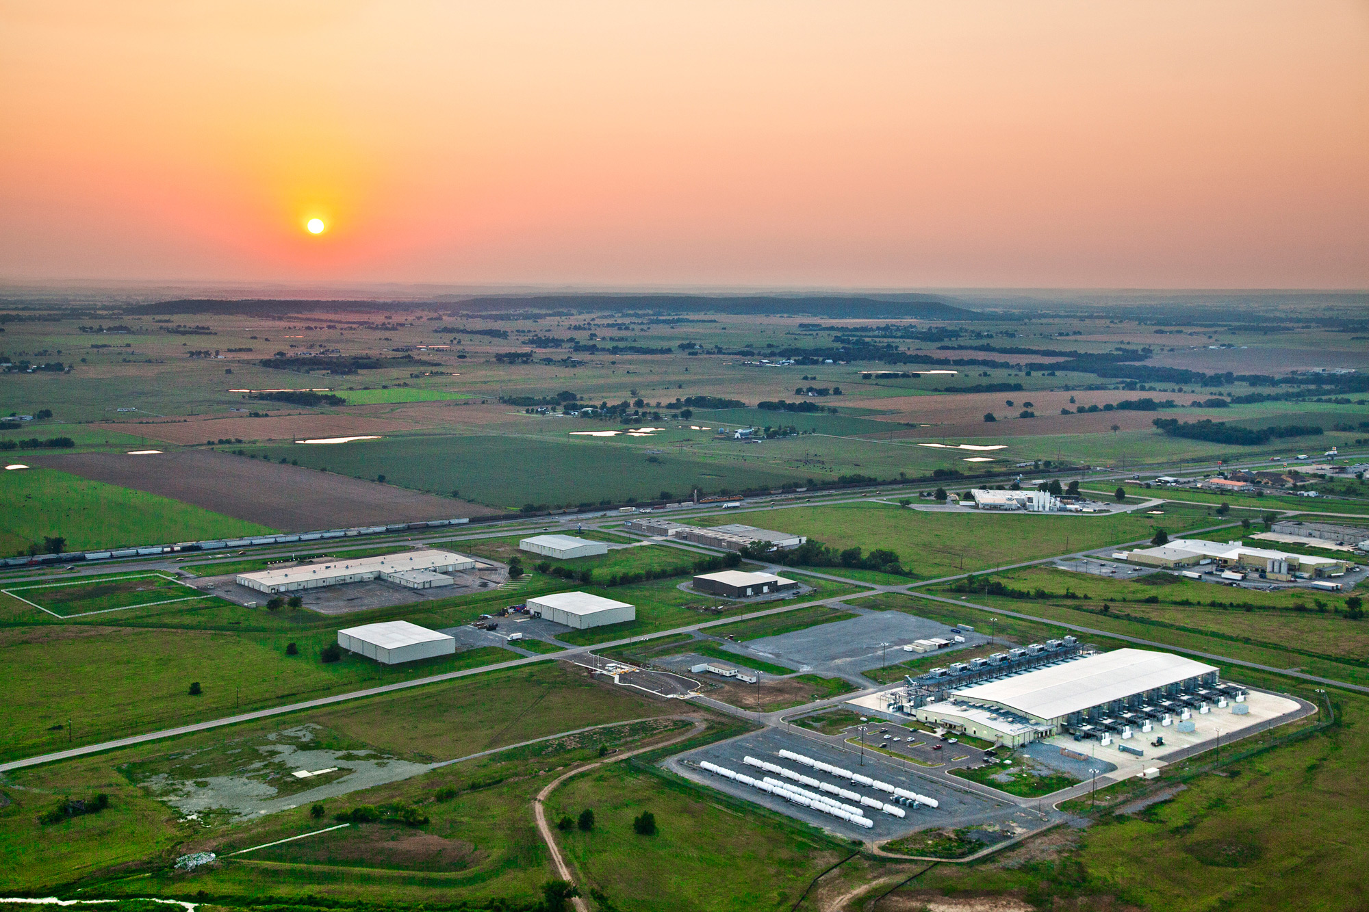
The datacenter is the computer!
Source: Google

Slide 23
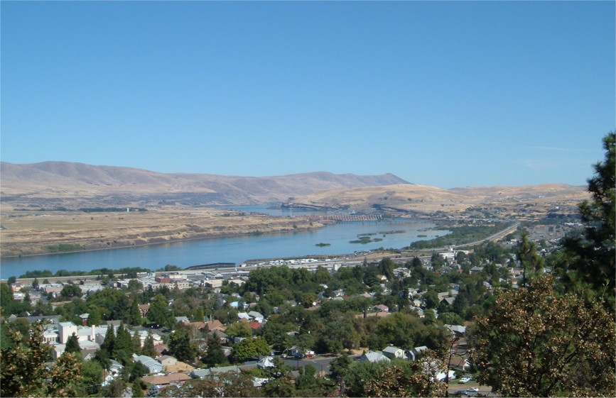
Source: Wikipedia (The Dalles, Oregon)

Slide 24
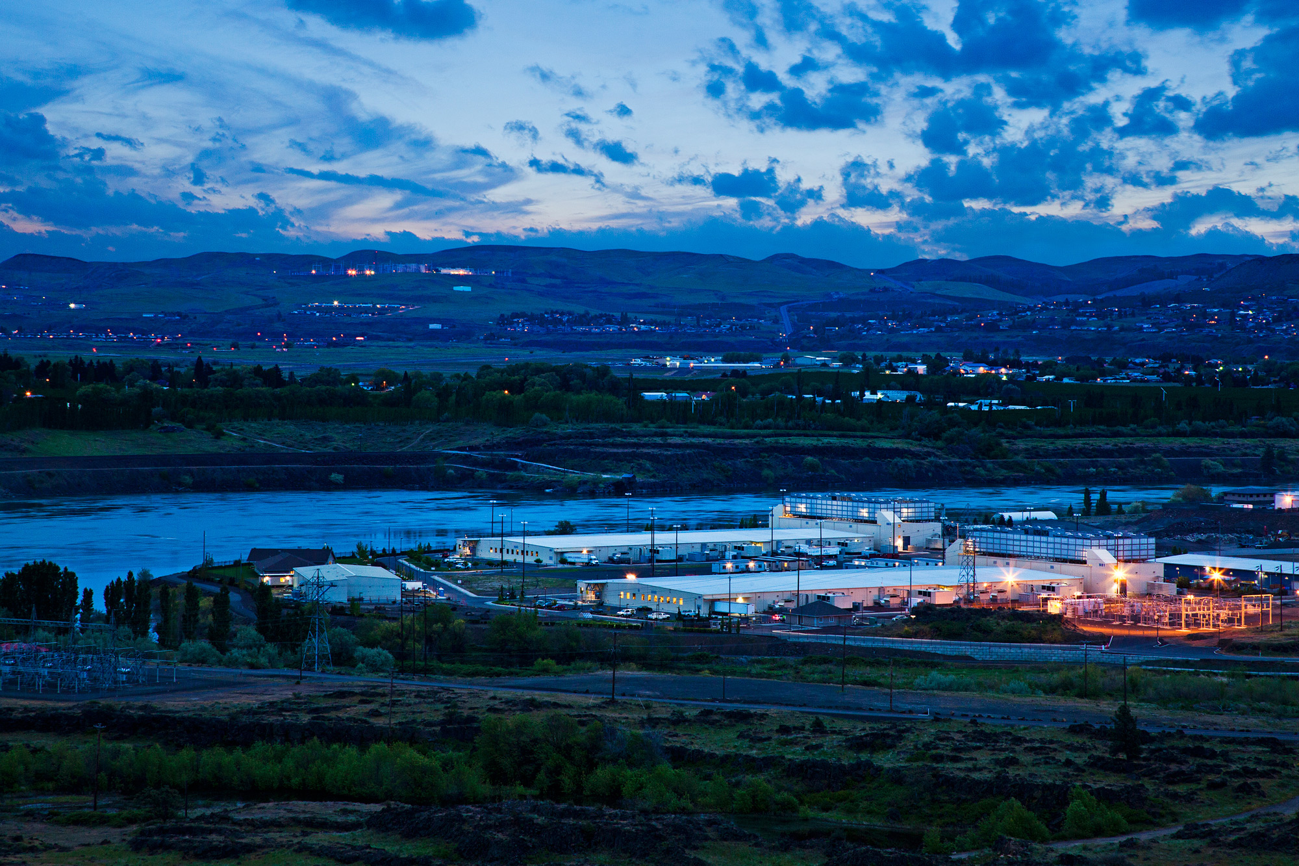
Source: Google

Slide 25
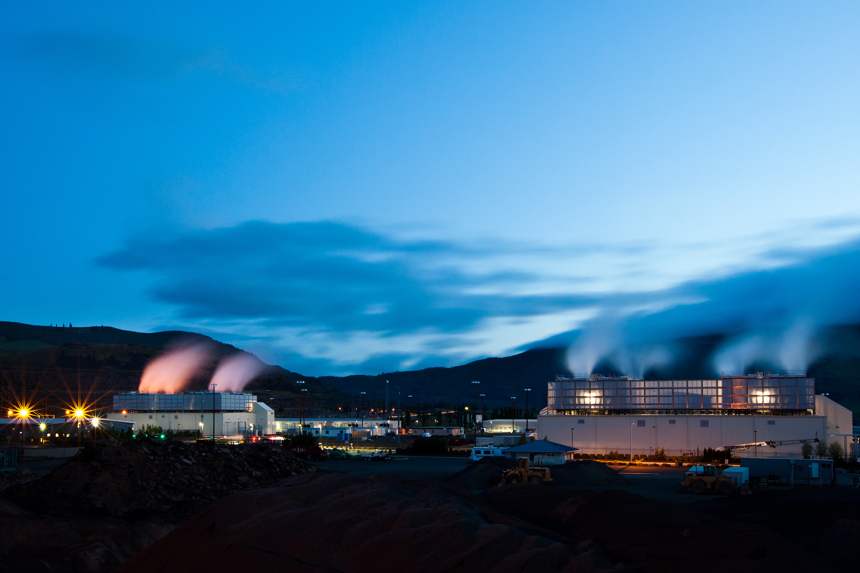
Source: Google

Slide 26
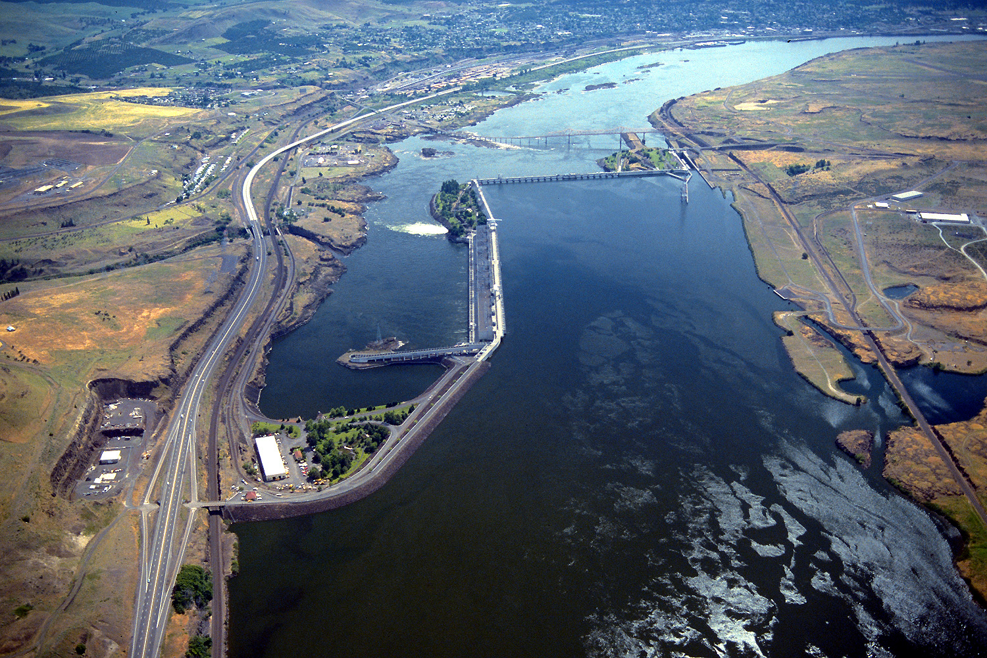
Source: Bonneville Power Administration

Slide 27
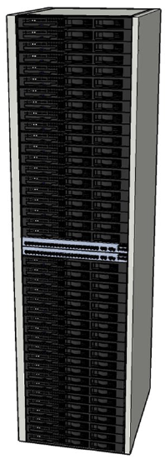
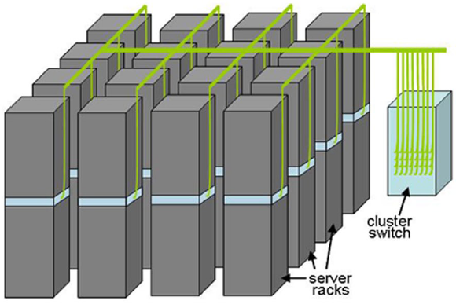
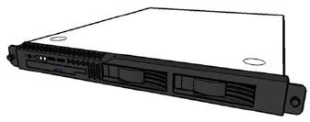
Building Blocks
Source: Barroso and Urs Hölzle (2009)

Slide 28
Source: Google

Slide 29
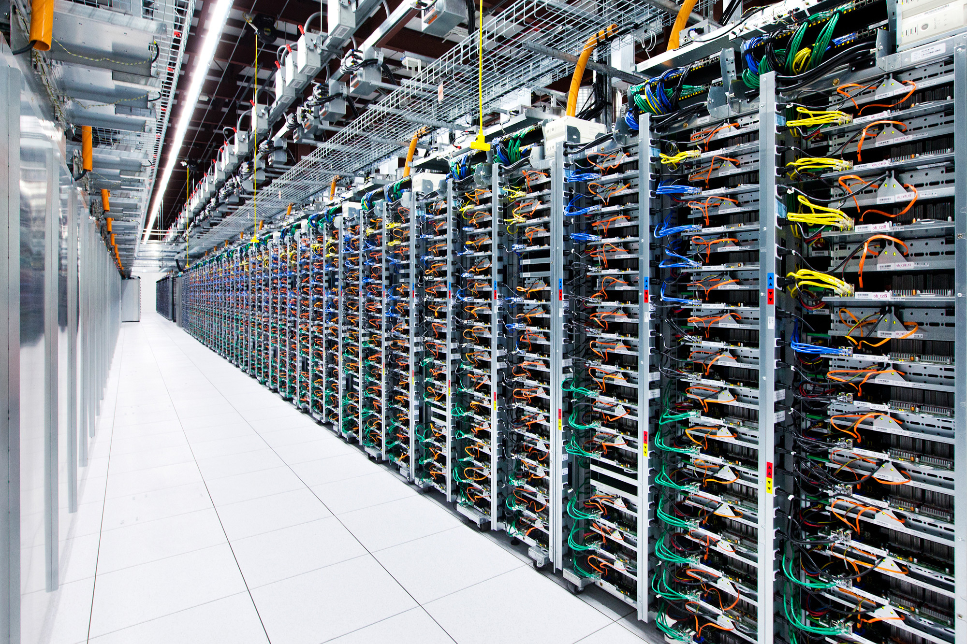
Source: Google

Slide 30
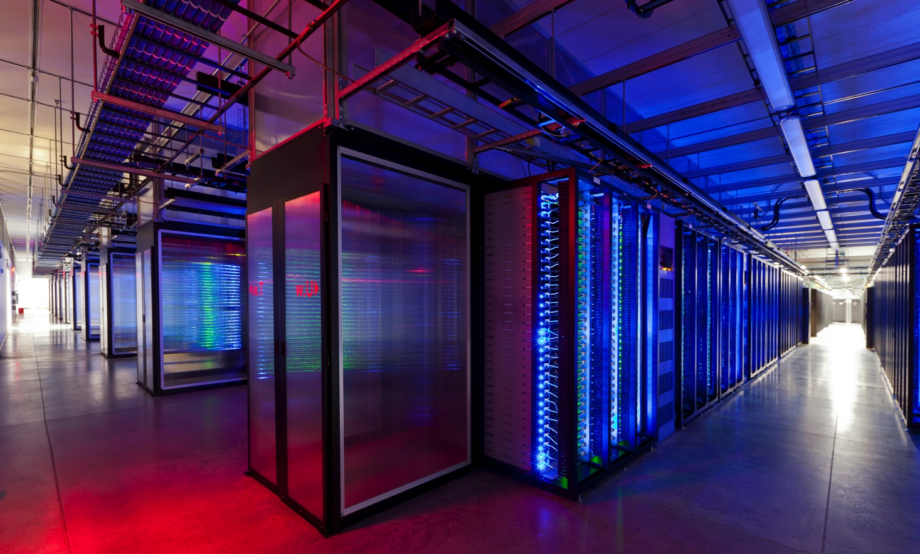
Source: Facebook

Slide 31
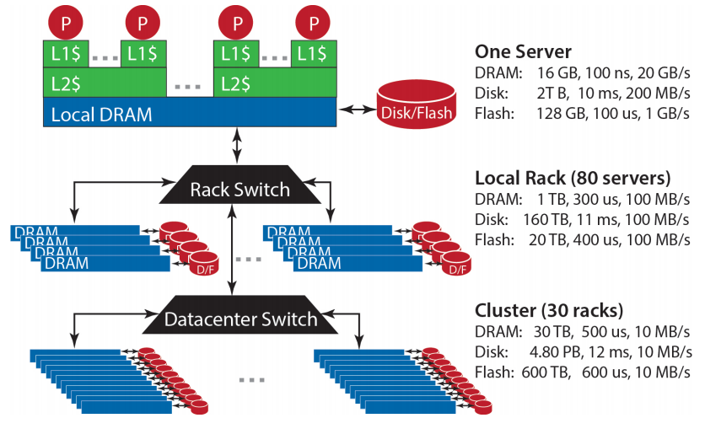
Storage Hierarchy
Source: Barroso and Urs Hölzle (2013)

Slide 32
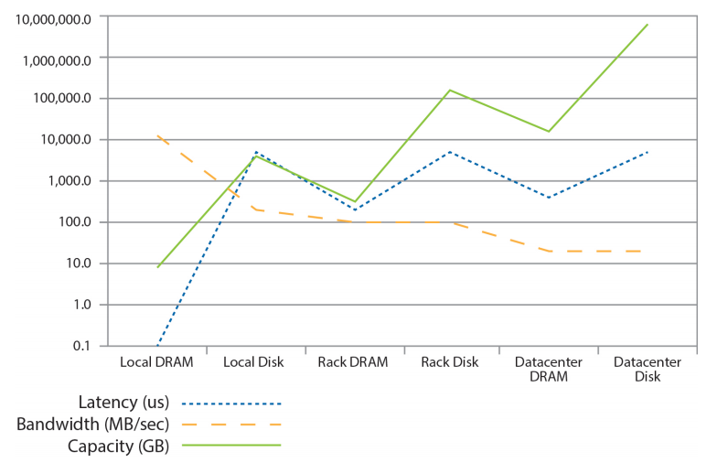
Storage Hierarchy
Source: Barroso and Urs Hölzle (2013)

Slide 33
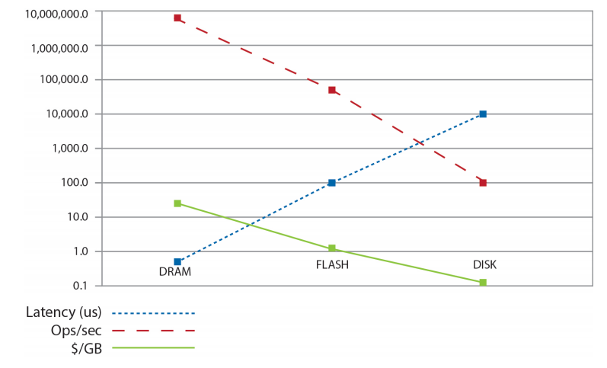
Storage Hierarchy
Source: Barroso and Urs Hölzle (2013)

Slide 34
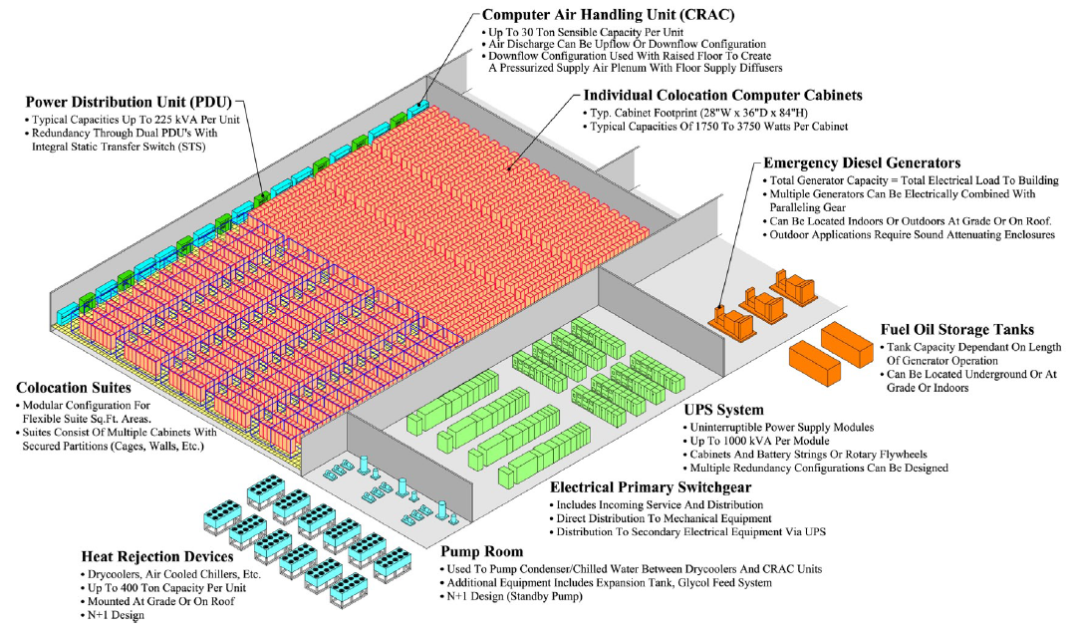
Anatomy of a Datacenter
Source: Barroso and Urs Hölzle (2013)

Slide 35
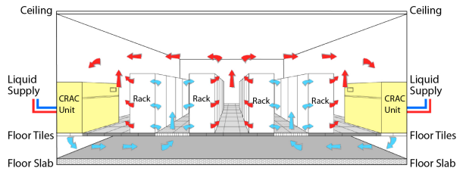
Anatomy of a Datacenter
Source: Barroso and Urs Hölzle (2013)

Slide 36
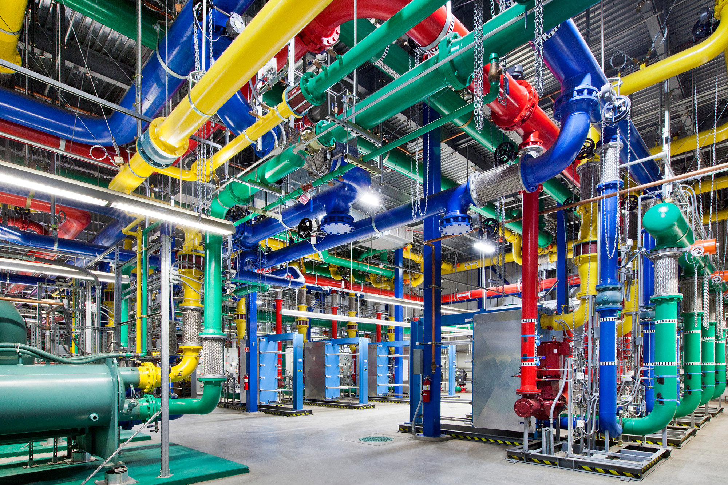
Source: Google

Slide 37
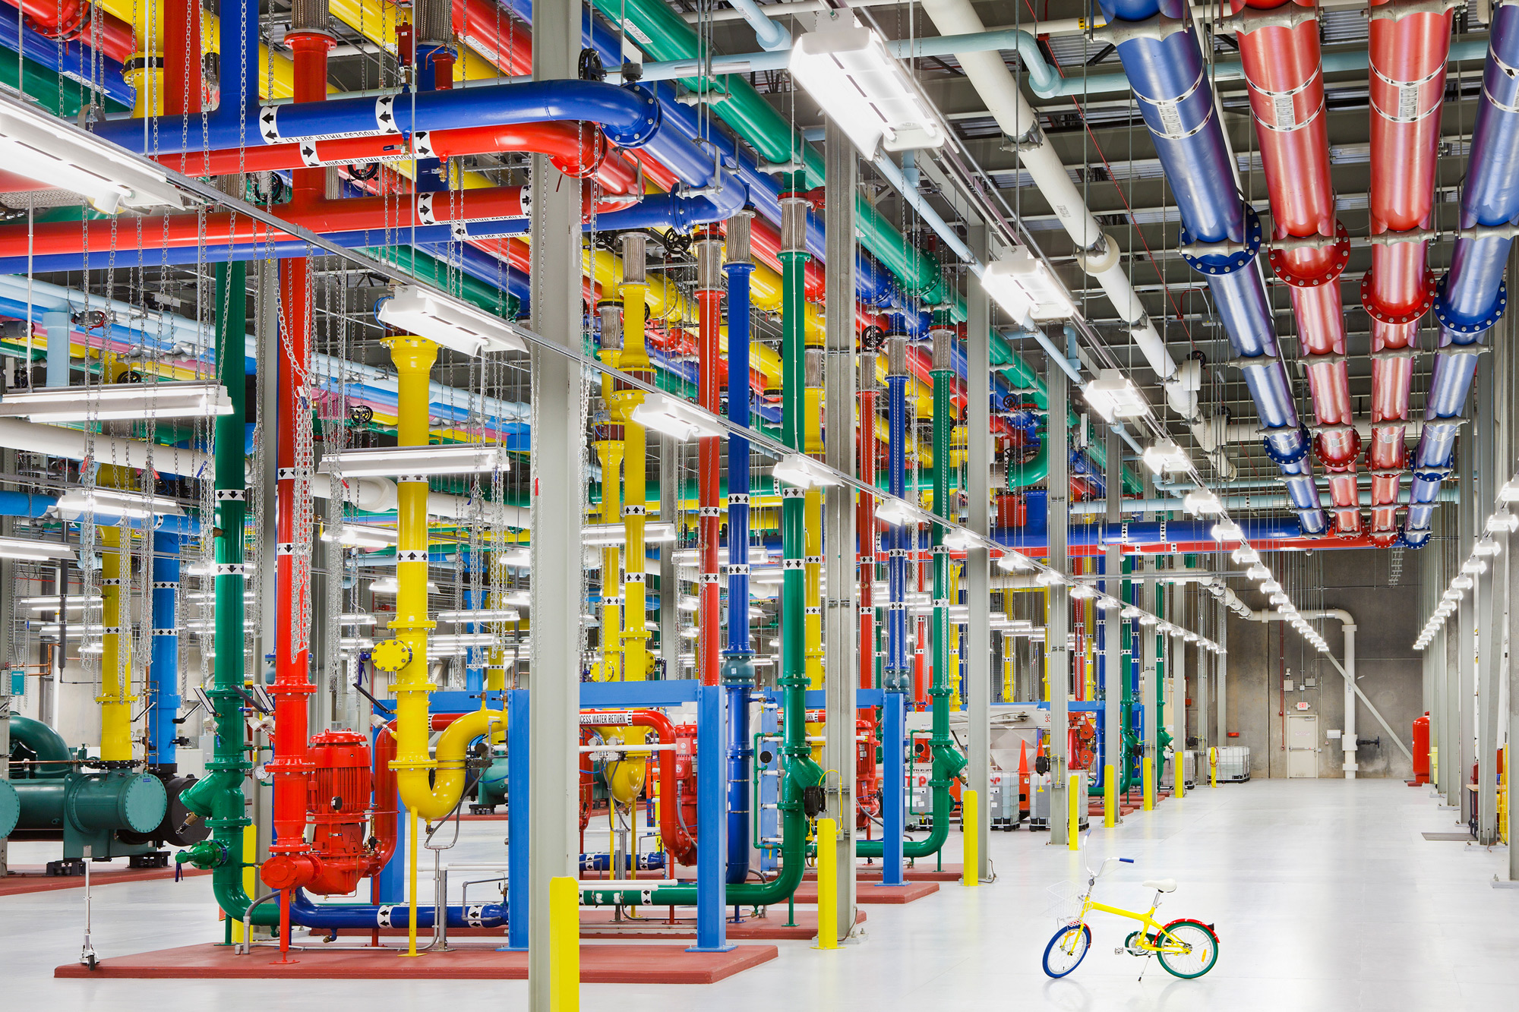
Source: Google

Slide 38
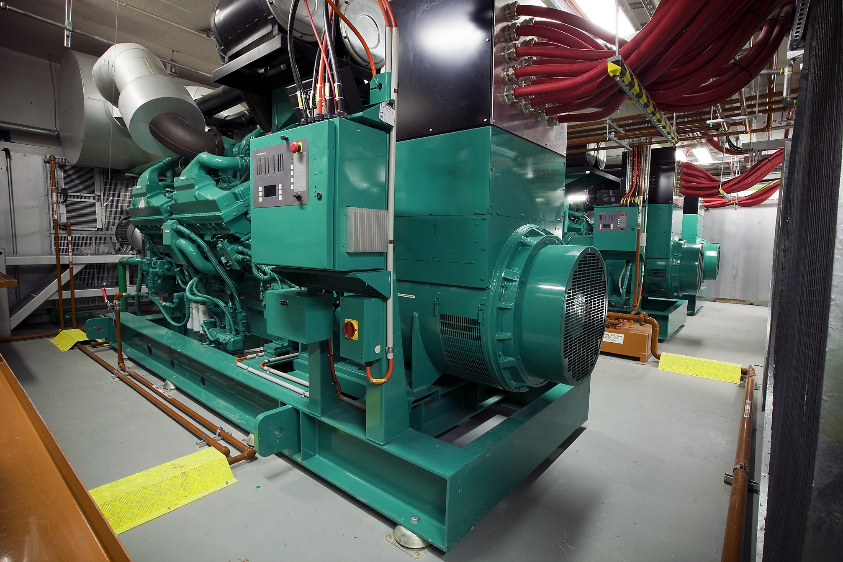
Source: CumminsPower

Slide 39
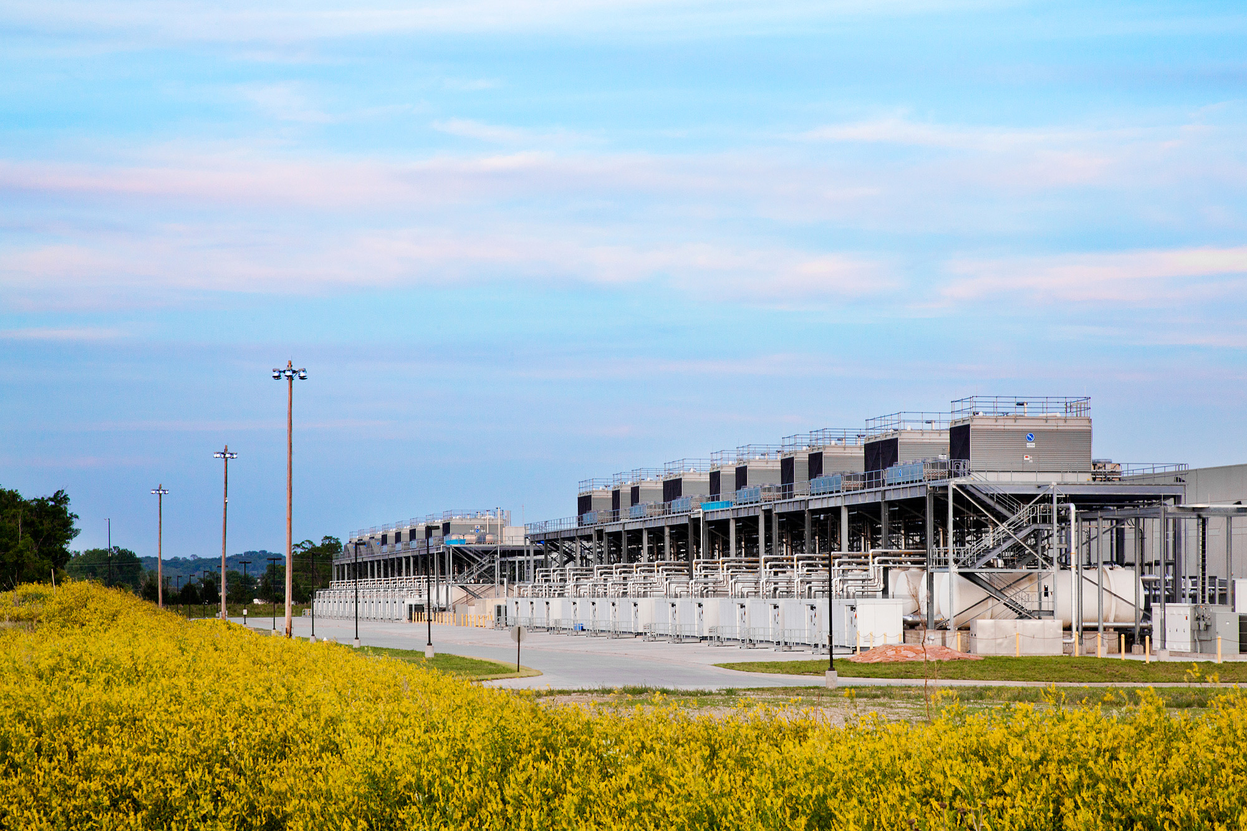
Source: Google

Slide 40
Aside: How much is 30 MW?
Source: Google

Slide 41
The datacenter is the computer
It’s all about the right level of abstraction
Moving beyond the von Neumann architecture
What’s the “instruction set” of the datacenter computer?
Hide system-level details from the developers
No more race conditions, lock contention, etc.
No need to explicitly worry about reliability, fault tolerance, etc.
Separating the what from the how
Developer specifies the computation that needs to be performed
Execution framework (“runtime”) handles actual execution

Slide 42
“Big Ideas”
Scale “out”, not “up”
Limits of SMP and large shared-memory machines
Move processing to the data
Cluster have limited bandwidth
Process data sequentially, avoid random access
Seeks are expensive, disk throughput is reasonable
Seamless scalability
From the mythical man-month to the tradable machine-hour

Slide 43
Scaling “up” vs. “out”
No single machine is large enough
Smaller cluster of large SMP machines vs. larger cluster of commodity machines (e.g., 16 128-core machines vs. 128 16-core machines)
Nodes need to talk to each other!
Intra-node latencies: ~100 ns
Inter-node latencies: ~100 μs
Let’s model communication overhead…
Source: analysis on this an subsequent slides from Barroso and Urs Hölzle (2009)

Slide 44
Modeling Communication Costs
Simple execution cost model:
Total cost = cost of computation + cost to access global data
Fraction of local access inversely proportional to size of cluster
n nodes (ignore cores for now)
Light communication: f =1
Medium communication: f =10
Heavy communication: f =100
What are the costs in parallelization?
1 ms + f × [100 ns × (1/n) + 100 μs × (1 - 1/n)]

Slide 45
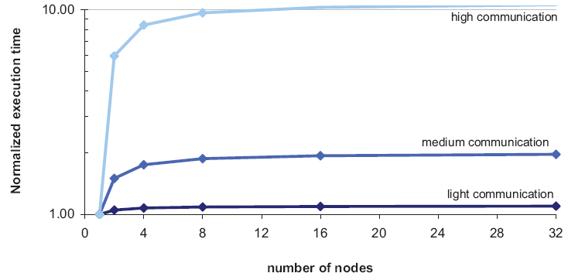
Cost of Parallelization

Slide 46
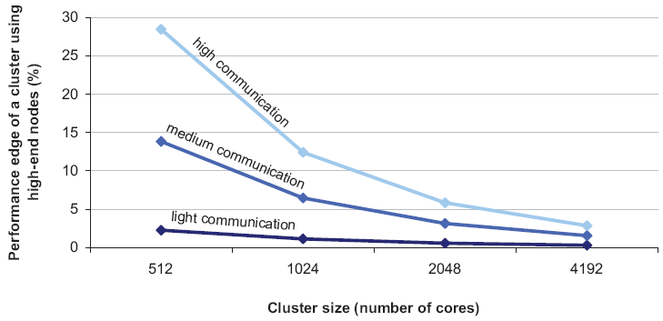
Advantages of scaling “up”
So why not?
Why does commodity beat exotic?

Slide 47
Counterpoint: Scaling up?
No single machine is large enough
Smaller cluster of large SMP machines vs. larger cluster of commodity machines (e.g., 16 128-core machines vs. 128 16-core machines)
Is this really true? Modern “commodity” machine:
Four 18-core processors: 72 cores total
3TB RAM
Who really has big data problems?

Slide 48
According to Jeff Dean

Slide 49
Moving Data Around
Source: Barroso and Urs Hölzle (2013)

Slide 50
Seeks vs. Scans
Consider a 1 TB database with 100 byte records
We want to update 1 percent of the records
Scenario 1: random access
Each update takes ~30 ms (seek, read, write)
10⁸ updates = ~35 days
Scenario 2: rewrite all records
Assume 100 MB/s throughput
Time = 5.6 hours(!)
Lesson: avoid random seeks!
Source: Ted Dunning, on Hadoop mailing list

Slide 51
Justifying the “Big Ideas”
Scale “out”, not “up”
Limits of SMP and large shared-memory machines
Move processing to the data
Cluster have limited bandwidth
Process data sequentially, avoid random access
Seeks are expensive, disk throughput is reasonable
Seamless scalability
From the mythical man-month to the tradable machine-hour

Slide 52
k₁
v₁
k₂
v₂
k₃
v₃
k₄
v₄
k₅
v₅
k₆
v₆
map
map
map
map
a
1
b
2
c
3
c
6
a
5
c
2
b
7
c
8
combine
combine
combine
combine
a
1
b
2
c
9
a
5
c
2
b
7
c
8
partition
partition
partition
partition
Shuffle and Sort: aggregate values by keys
a
1
5
b
2
7
c
c
2
2
9
3
8
6
8
reduce
reduce
reduce
r₁
s₁
r₂
s₂
r₃
s₃

Slide 53

How do we get data to the workers?
NAS
SAN
Compute Nodes
What’s the problem here?

Slide 54
Distributed File System
Don’t move data to workers… move workers to the data!
Store data on the local disks of nodes in the cluster
Start up the workers on the node that has the data local
Why?
(Perhaps) not enough RAM to hold all the data in memory
Disk access is slow, but disk throughput is reasonable
A distributed file system is the answer
GFS (Google File System) for Google’s MapReduce
HDFS (Hadoop Distributed File System) for Hadoop

Slide 55
GFS: Assumptions
Commodity hardware over “exotic” hardware
Scale “out”, not “up”
High component failure rates
Inexpensive commodity components fail all the time
“Modest” number of huge files
Multi-gigabyte files are common, if not encouraged
Files are write-once, mostly appended to
Perhaps concurrently
Large streaming reads over random access
High sustained throughput over low latency
GFS slides adapted from material by (Ghemawat et al., SOSP 2003)

Slide 56
GFS: Design Decisions
Files stored as chunks
Fixed size (64MB)
Reliability through replication
Each chunk replicated across 3+ chunkservers
Single master to coordinate access, keep metadata
Simple centralized management
No data caching
Little benefit due to large datasets, streaming reads
Simplify the API
Push some of the issues onto the client (e.g., data layout)
HDFS = GFS clone (same basic ideas)

Slide 57
From GFS to HDFS
Terminology differences:
GFS master = Hadoop namenode
GFS chunkservers = Hadoop datanodes
Differences:
Different consistency model for file appends
Implementation
Performance
For the most part, we’ll use Hadoop terminology…

Slide 58
HDFS Architecture
HDFS namenode
Application
/foo/bar
(file name, block id)
File namespace
HDFS Client
block 3df2
(block id, block location)
instructions to datanode
(block id, byte range)
datanode state
HDFS datanode
HDFS datanode
block data
Linux file system
Linux file system
…
…
Adapted from (Ghemawat et al., SOSP 2003)

Slide 59
Namenode Responsibilities
Managing the file system namespace:
Holds file/directory structure, metadata, file-to-block mapping, access permissions, etc.
Coordinating file operations:
Directs clients to datanodes for reads and writes
No data is moved through the namenode
Maintaining overall health:
Periodic communication with the datanodes
Block re-replication and rebalancing
Garbage collection

Slide 60
k₁
v₁
k₂
v₂
k₃
v₃
k₄
v₄
k₅
v₅
k₆
v₆
map
map
map
map
a
1
b
2
c
3
c
6
a
5
c
2
b
7
c
8
combine
combine
combine
combine
a
1
b
2
c
9
a
5
c
2
b
7
c
8
partition
partition
partition
partition
Shuffle and Sort: aggregate values by keys
a
1
5
b
2
7
c
c
2
2
9
3
8
6
8
reduce
reduce
reduce
r₁
s₁
r₂
s₂
r₃
s₃

Slide 61
Putting everything together…
namenode
job submission node
namenode daemon
jobtracker
tasktracker
tasktracker
tasktracker
datanode daemon
datanode daemon
datanode daemon
Linux file system
Linux file system
Linux file system
…
…
…
slave node
slave node
slave node
(Not Quite… We’ll come back to YARN later)

Slide 62
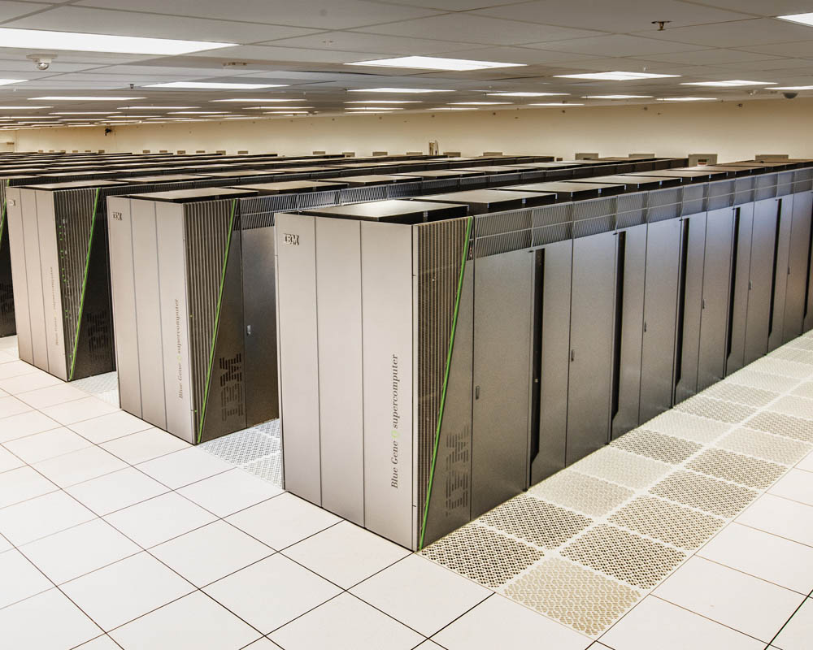
Sequoia
16.32 PFLOPS
98,304 nodes with 1,572,864 million cores 1.6 petabytes of memory
7.9 MWatts total power

Slide 63
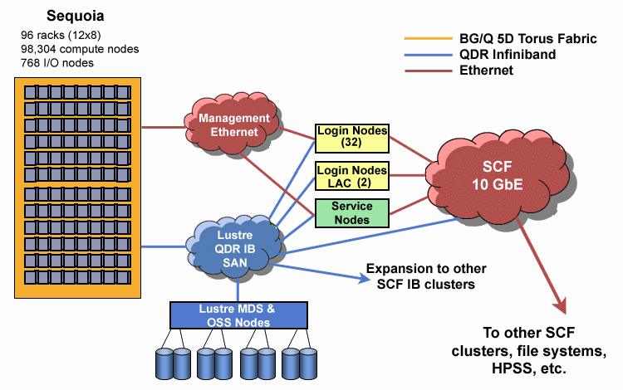
Source: LLNL

Slide 64

Aside: Cloud Computing
Source: Wikipedia (Clouds)

Slide 65
The best thing since sliced bread?
Before clouds…
Grids
Connection machine
Vector supercomputers
…
Cloud computing means many different things:
Big data
Rebranding of web 2.0
Utility computing
Everything as a service

Slide 66
Rebranding of web 2.0
Rich, interactive web applications
Clouds refer to the servers that run them
AJAX as the de facto standard (for better or worse)
Examples: Facebook, YouTube, Gmail, …
“The network is the computer”: take two
User data is stored “in the clouds”
Rise of the netbook, smartphones, etc.
Browser is the OS

Slide 67
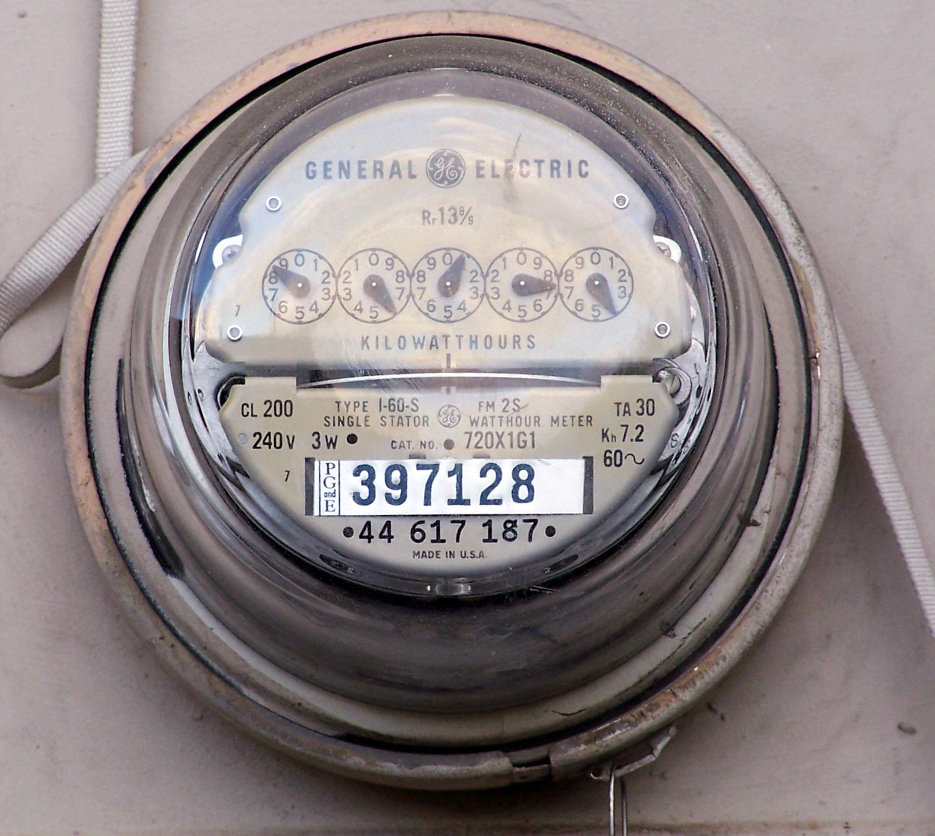
Source: Wikipedia (Electricity meter)

Slide 68
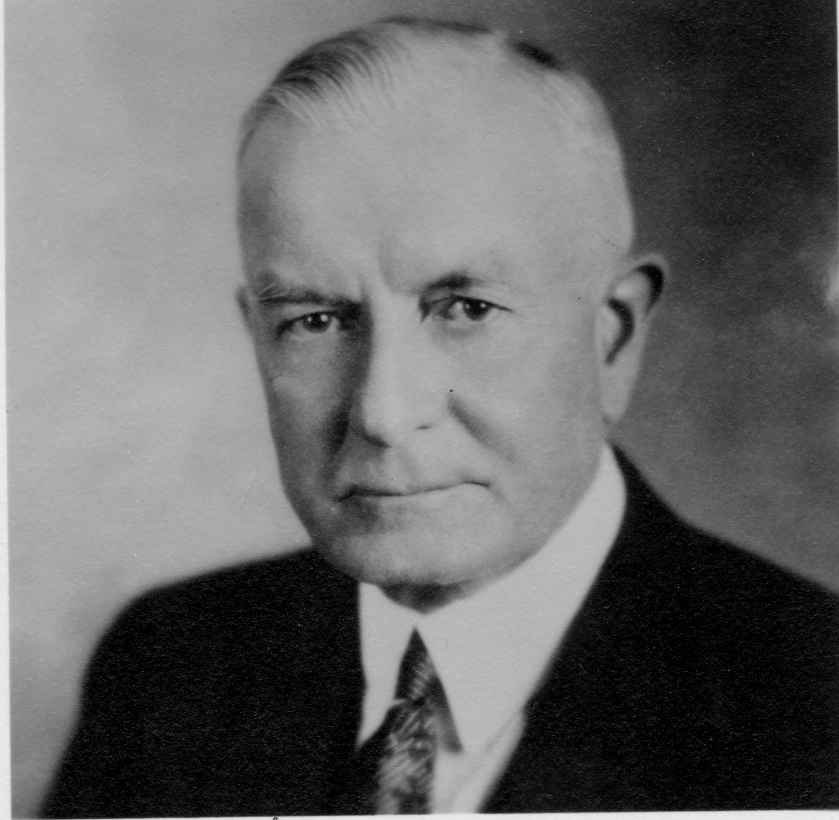
Utility Computing
What?
Computing resources as a metered service (“pay as you go”)
Ability to dynamically provision virtual machines
Why?
Cost: capital vs. operating expenses
Scalability: “infinite” capacity
Elasticity: scale up or down on demand
Does it make sense?
Benefits to cloud users
Business case for cloud providers
I think there is a world market for about five computers.

Slide 69
Enabling Technology: Virtualization
App
App
App
App
App
App
OS
OS
OS
Operating System
Hypervisor
Hardware
Hardware
Traditional Stack
Virtualized Stack

Slide 70
Everything as a Service
Utility computing = Infrastructure as a Service (IaaS)
Why buy machines when you can rent cycles?
Examples: Amazon’s EC2, Rackspace
Platform as a Service (PaaS)
Give me nice API and take care of the maintenance, upgrades, …
Example: Google App Engine
Software as a Service (SaaS)
Just run it for me!
Example: Gmail, Salesforce

Slide 71
Who cares?
A source of problems…
Cloud-based services generate big data
Clouds make it easier to start companies that generate big data
As well as a solution…
Ability to provision analytics clusters on-demand in the cloud
Commoditization and democratization of big data capabilities

Slide 72
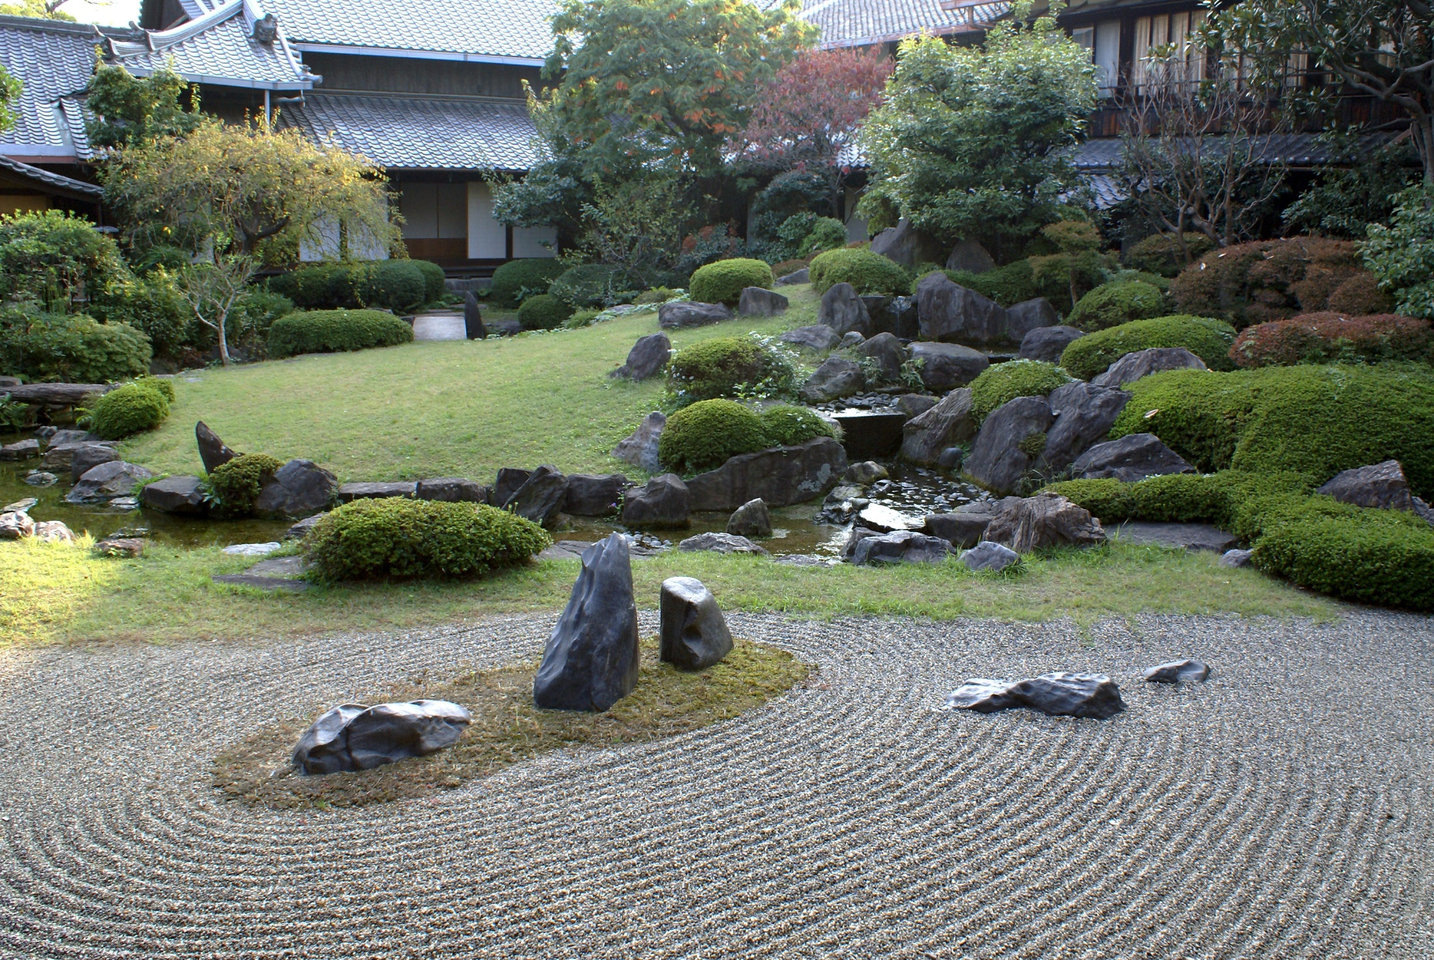
Questions?
Remember: Assignment 0 due next Tuesday at 8:30am
Source: Wikipedia (Japanese rock garden)

